Slide 1
Topic = Micro-Credit Defaulter predicationusing Machine Learning
[ Name: Saunak Mukherjee] [Institution: DataTrained] [Flip Robo Technology]

Slide 2
PROBLEM STATEMENT
A Microfinance Institution (MFI) is an organization that offers financial services to low income populations. MFS becomes very useful when targeting especially the unbanked poor families living in remote areas with not much sources of income. The Microfinance services (MFS) provided by MFI are Group Loans, Agricultural Loans, Individual Business Loans and so on.
Many microfinance institutions (MFI), experts and donors are supporting the idea of using mobile financial services (MFS) which they feel are more convenient and efficient, and cost saving, than the traditional high-touch model used since long for the purpose of delivering microfinance services. Though, the MFI industry is primarily focusing on low income families and are very useful in such areas, the implementation of MFS has been uneven with both significant challenges and successes.
Today, microfinance is widely accepted as a poverty-reduction tool, representing $70 billion in outstanding loans and a global outreach of 200 million clients.
We are working with one such client that is in Telecom Industry. They are a fixed wireless telecommunications network provider. They have launched various products and have developed its business and organization based on the budget operator model, offering better products at Lower Prices to all value conscious customers through a strategy of disruptive innovation that focuses on the subscriber.
They understand the importance of communication and how it affects a person’s life, thus, focusing on providing their services and products to low income families and poor customers that can help them in the need of hour.
They are collaborating with an MFI to provide micro-credit on mobile balances to be paid back in 5 days. The Consumer is believed to be defaulter if he deviates from the path of paying back the loaned amount within the time duration of 5 days. For the loan amount of 5 (in Indonesian Rupiah), payback amount should be 6 (in Indonesian Rupiah), while, for the loan amount of 10 (in Indonesian Rupiah), the payback amount should be 12 (in Indonesian Rupiah).
The sample data is provided to us from our client database. It is hereby given to you for this exercise. In order to improve the selection of customers for the credit, the client wants some predictions that could help them in further investment and improvement in selection of customers.

Slide 3
About DATASET
Dataset provide by Fliprobo Technologies Ltd.
Micro Credit Defaulter dataset contain 209593 rows and 37 columns.
Out of all features only three features with object datatypes and rest are int64.
Data integrity check is perform for missing values, duplicate data, data error.
No missing values are present in dataset.

Slide 4
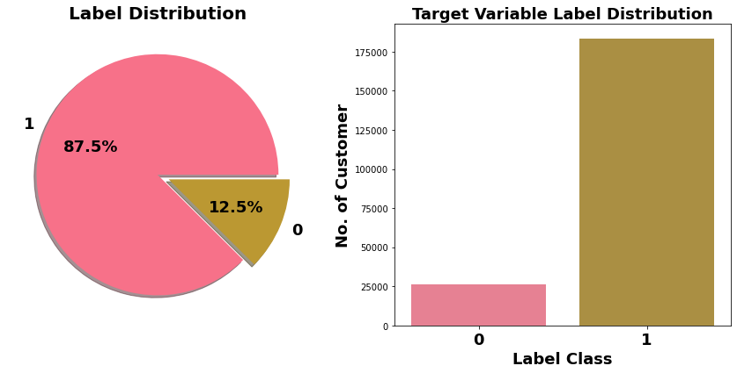
Exploration of Target Variable Ratings
There are Label class 1 represent non-defaulter while Label class 0 represent defaulter
Target Variable Label is imbalanced in nature.

Slide 5
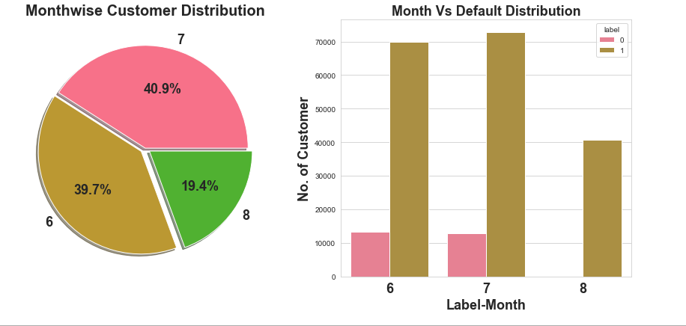
month 6 and 7, followed by month 8.

Slide 6
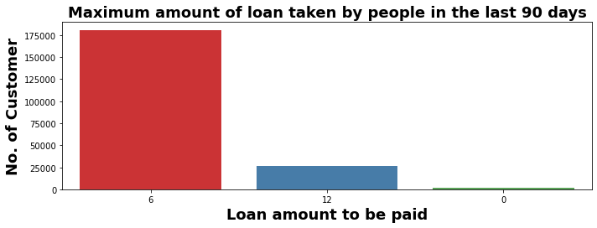
Exploratory Data Analysis
In 30 days, maximum number of people had taken 6Rs as the loan amount and the number of people is 179192 whereas the number of the people had not taken loan and their number is 4291.
In 90 days, there are maximum number of people had taken 6Rs as the loan amount and the number of people is 180944 whereas the number of people had not taken loan and their number is 2043.
Maximum number of people had taken 12Rs as the loan amount within 90 days and their number is 26605 whereas for 30 days the number of people who had taken 12Rs is 26109 respectively.

Slide 7
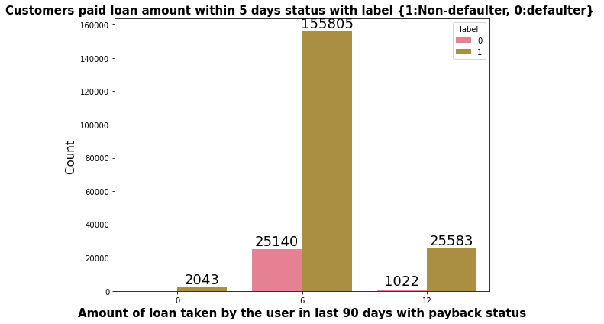
Exploratory Data Analysis
Very few defaulters in the case of a customers who have taken loan in amount of 12.

Slide 8
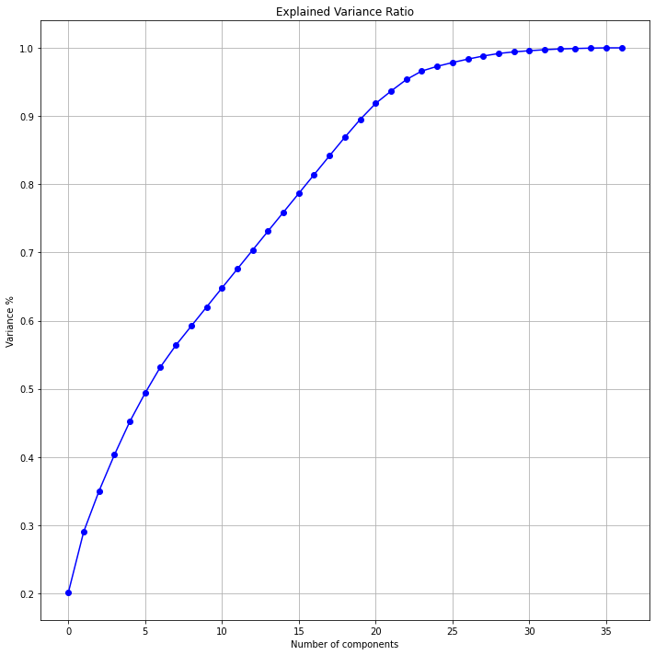
PCA
Multicollinearity which is exist between few features.
To resolve it PCA which is applied.
Eleven principal components attribute for the 90% of variation in the data.
PCA applied for a Eleven components.

Slide 9
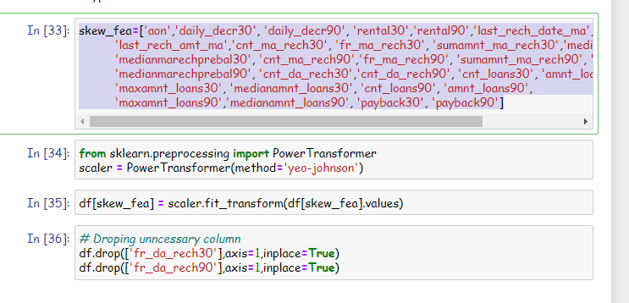
Feature engineering
Yeo-Johnson Power Transformation used to reduce skewness.

Slide 10
MACHINE LEARNING MODEL BUILDING
We have seen that we have to predict customer is defaulter or not. It can be solve by application of the classification ML algorithm.
Different Classification algorithm used to train model, in order to have maximum accuracy score.
Machine learning classification algorithms used in this project are –
Logistics Regression
Decision Tree Classifier
Extra Tree Classifier
RandomForestClassifier

Slide 11
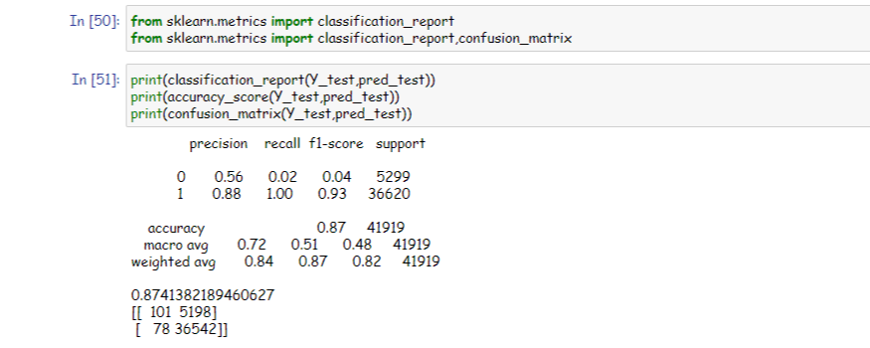
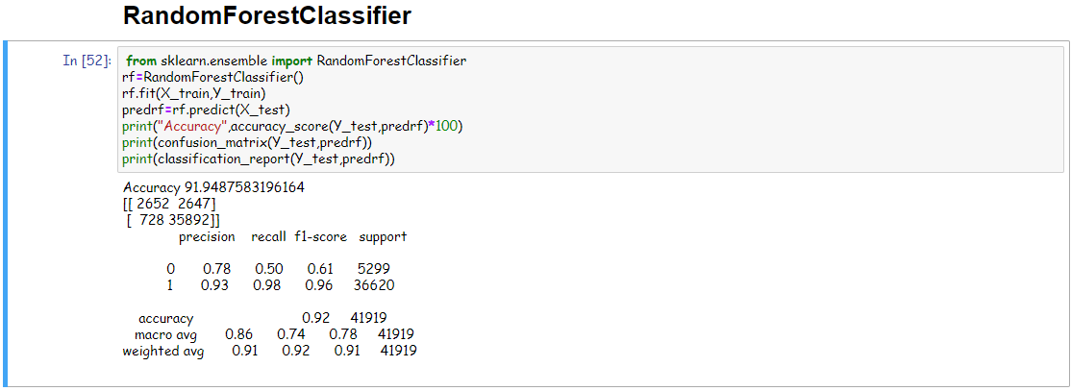
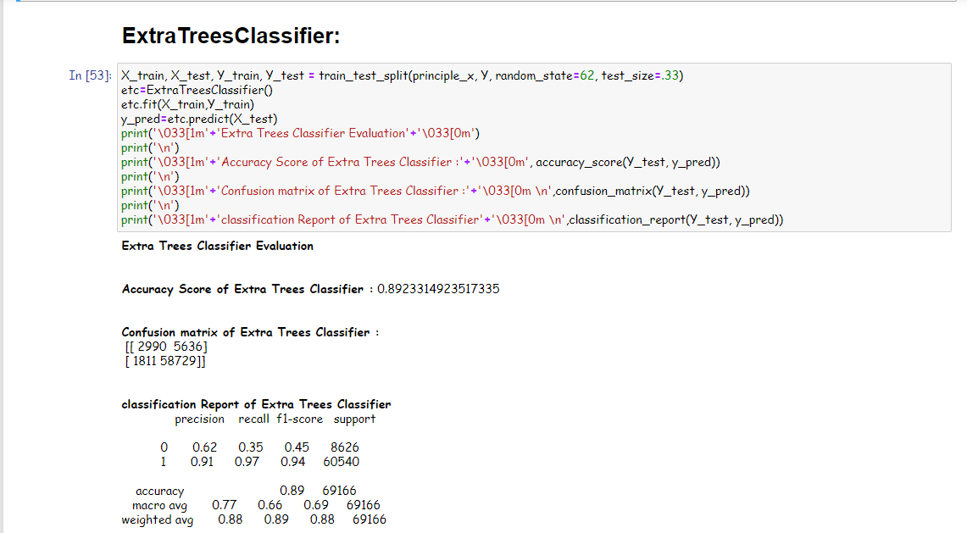
Matrix

Slide 12
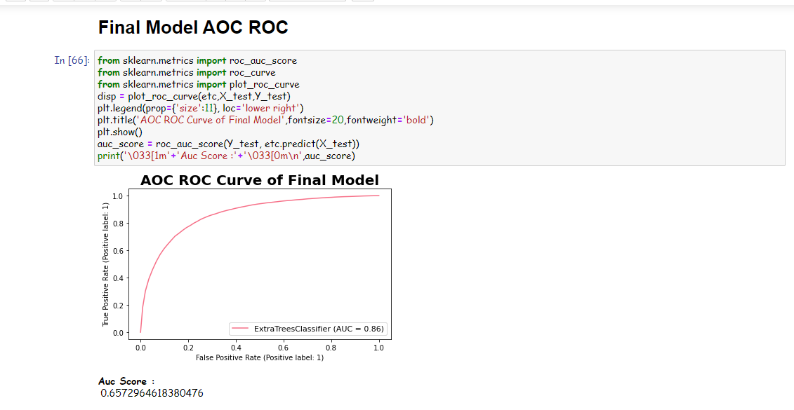
Final AUC ROC curve

Slide 13
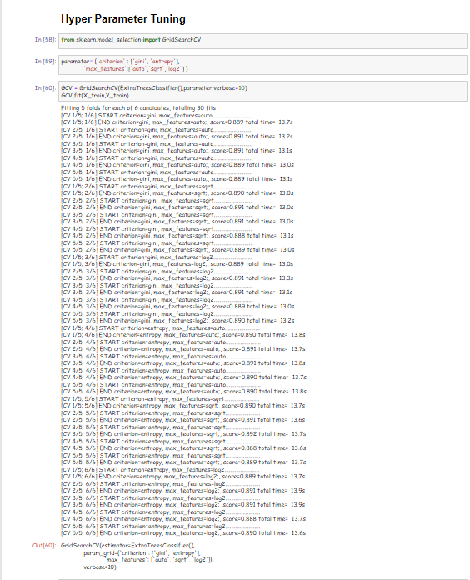
Hyperparameter Tunning

Slide 14
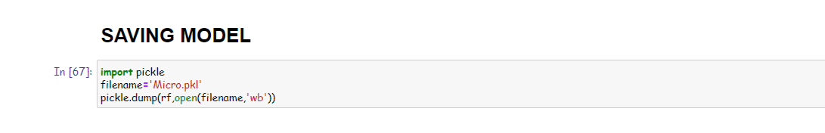
Final Model Saving

Slide 15
Thank You

